Slide 1


Slide 2
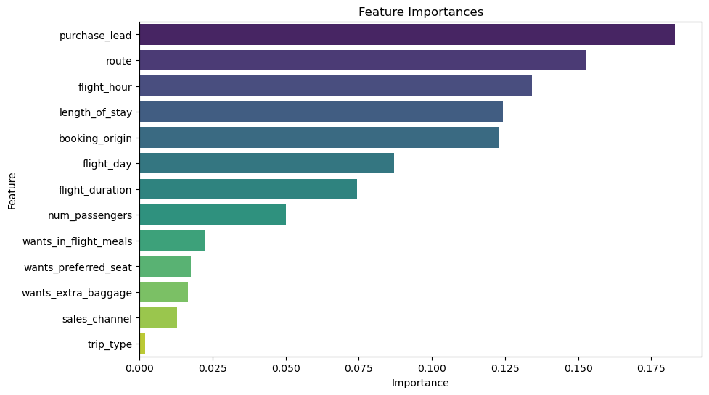
Predicting customer’s buying behaviour
The approach utilised a random forest classifier to forecast a customer's purchasing behaviour.
Accuracy score : 0.8541
The top 5 feature importance were:
purchase_lead - 0.183204 route - 0.152632 flight_hour - 0.134099 length_of_stay - 0.12419 booking_origin - 0.123070

